Slide 1
Photo: Mark Kaye/Save the Children
Leveraging the Scaling Up Nutrition Civil Society Network: building regional platforms to promote learning on how to address malnutrition
The Learning Route in Rwanda
EXPERIENCE FAIR
30 October 2016, Kigali, Rwanda
Country Team Members: Insert names

Slide 2
SUN CSA -KENYA:

Slide 3
What is the nutrition situation in your country?
Photo: Caroline Trutmann/Save the Children

Slide 4
What are the key National interventions to tackle malnutrition in your country?
Key interventions
challenges
Low Funding
Low demand for nutrition services
Lessons learnt
Advocacy is very important for both supply and demand for services. More duty bearers-rights holders platform needed.
Working with the key government agencies for leadership and advocacy for resources allocation for scaling up nutrition is likely more successful as opposed to advocating alone.
Weak multi-sectoral collaboration in tackling malnutrition
Marginalization of nutrition in the home sectors
Low utilization of information for decision making
Weak capacity on nutrition advocacy
Nutrition sensitive interventions, if given equal priorities as nutrition sensitive, can greatly improve nutrition status of the country- need for strong MSP
Zinc supplementation
Exclusive breast feeding
Complementary feeding
Vitamin A supplementation
Iron folate supplementation
Deworming
Integrated management of acute malnutrition
Iron Folate supplementation of pregnant women
Food fortification
Salt Iodization
Improved Hygiene practices
High Impact Nutrition Interventions:

Slide 5
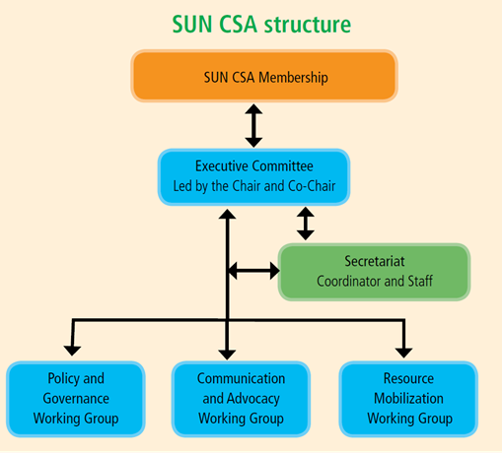
Presentation of the CSA
Establishment started in 2013- by five implementing partners.
Taskforce formed in October 2013 to activate the SUN Networks.
5th November, interim CSA governance structures established.
9th May 2014- SUN CSA officially launched.
Governance structure:
Chairperson must be local NGO
Comprises 45 national and INGOS
Each member in a sub-committee.
Work majorly in the 47 counties.

Slide 6
Key intervention area of the CSA and key achievements
Key intervention areas
Key achievements (and date)
Explicit nutrition budget lines created in the county budgets. Examples: 2015/16; Baringo 4M, Taita Taveta 2M. Others Kajiado, West Pokot, Wajir and Mandera. 2016/17- increase in budget for the above counties, Nairobi 30M, Tana River 4.8M,
Developing and launching SUN CSA strategic plan- June 2016.
Influencing policy and supporting development of strategic documents (CNAP, NACSM Strategy-June 2016
Engaging the media in nutrition reporting- continuous.
Initiating MSPs at county levels.
Elevation of nutrition in the government structures.
Mainstreaming nutrition as a multi-sectoral development agenda.
Advocacy for increased investment in nutrition (budget & HR)
SUN CSA Institutional strengthening and development
Photo: Caroline Trutmann/Save the Children

Slide 7
Who are the most influential nutrition stakeholders in your country? Insert a Map of Stakeholders
First lady of the republic of Kenya and the county first ladies.
Head of nutrition unit
SUN CSA
Other government departments (agriculture, education, water, social protection etc.)
County nutrition coordinators.
Council of governors
County and national assemblies (health and budget committees)
Media
Bunge la wananchi (people’s parliaments) at community levels
UN agencies
Donor community
Business community.
Academia.

Slide 8
CSA call For Action Statement
Failing to invest in nutrition can lead to huge economic losses. National and county governments must prioritise budget allocations for nutrition in their planning by creating specific nutrition budget lines and focus investments on High Impact Nutrition Interventions to maximise the results on the ground.
The development partners and the donor community to - at a minimum - double the share of their budgets allocated to improving nutrition to tackle malnutrition in Kenya.
The Government of Kenya needs to fast-track the establishment and high-level positioning of multi-sectoral platforms on food and nutrition security, at both national and county levels, to coordinate and maximize nutrition-related dialogues, investments and actions from all sectors.

Slide 9
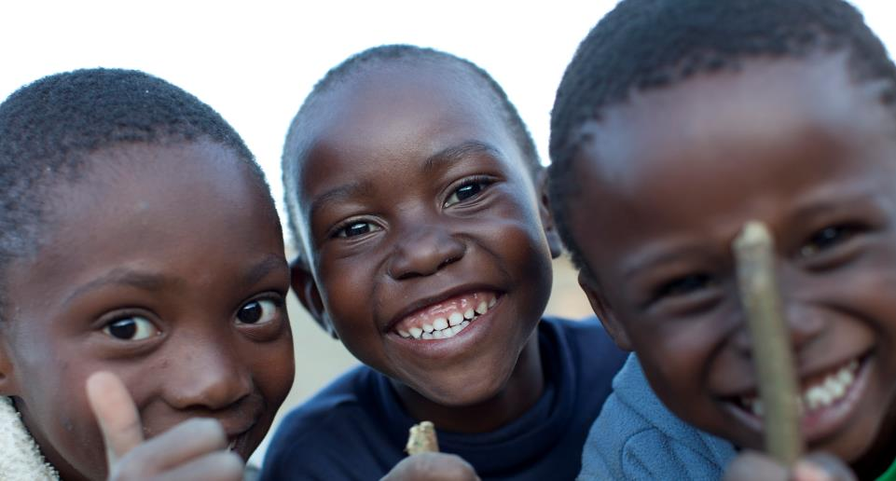
Thank you!
Photo: Adam Hinton/Save the Children

