Slide 1
Photo: Mark Kaye/Save the Children
Leveraging the Scaling Up Nutrition Civil Society Network: building regional platforms to promote learning on how to address malnutrition
The Learning Route in Rwanda
EXPERIENCE FAIR
30 October 2016, Kigali, Rwanda
Country Team Members: Insert names

Slide 2
Civil Society Organisation Nutrition Alliance:

Slide 3
What is the nutrition situation in your country?
 | 2004 MDHS | 2010 MDHS | 2014 MDG ENDLINE survey | 2015/16 MDHS
under five stunting | 48% | 47% | 42% | 37%
low birth weight |  | 13.9% | 12.9%
under five wasting | 5% | 4% | 3.8% | 3%
0-6 Months exclusive breastfeeding | 53% | 71.4% | 70.2% | 61.2%
Under five overweight |  |  | 5.1%
Women Anaemia | 44% | 28% |  | 33%
Photo: Caroline Trutmann/Save the Children

Slide 4
What are the key National interventions to tackle malnutrition in your country?
Increase and diversify dietary intake, for optimal nutrition particularly for maternal, infant and young children and adolescent girls with safe nutritious foods
at community and household levels.
Support improved access to and availability of adequate (quality and quantity) diversified diets following the Malawi 6 food groups
Livelihood based social support e.g. Village Saving and loan (VSL) and cash transfers, food for work, work for asset.
Primary health care, therapeutic care, support and treatment
Community Management of Acute Malnutrition under Targeted Nutrition Program (SFP, OTP, NRU, NCST)
Support health seeking behaviours for maternal, infant and young child
Promote infant and young child feeding
Promote micronutrient supplementation

Slide 5
What are the key National interventions to tackle malnutrition in your country?
Integrate behavioural change and communication for optimal maternal, infant and young child feeding and care practices among learners, professional and frontline workers
Behavioural change (nutrition knowledge, attitude and practises)
Productive school environment i.e. pro mote nutrition education in learning and education centres
Early childhood care and development
Support school health and nutrition programs
Improve overall sector governance, coordination, human capacity development, and operational research, M&E framework and Fortification.
Support training in nutrition
Nutrition advocacy
Support operational research

Slide 6
Challenges Faced
Inadequate resources i.e. human resource, financial resource and infrastructure towards nutrition at all levels
Poor coordination between government, CSOs, the private sector and the community to popularize nutrition efforts at community level.
Poor policy popularization from national level to the people at the grass roots
Inadequate understanding of nutrition, its impact on political, social and economic development among policy and law makers affecting resource mobilization and prioritization.

Slide 7
Presentation of the CSA
Founded in 2013 as a national coalition of CSOs committed to working towards sustained improvements in national nutrition efforts in alignment with global and national commitments for a healthy and productive Malawi.
CSONA Secretariat based in the Capital Lilongwe and governed by a Board of Members
Secretariat made up of 4 staff led by the national Coordinator
Currently membership stands at 106.
Membership comprises of local CSOs, INGOs, Media houses, Academia, CBOs and FBOs.

Slide 8
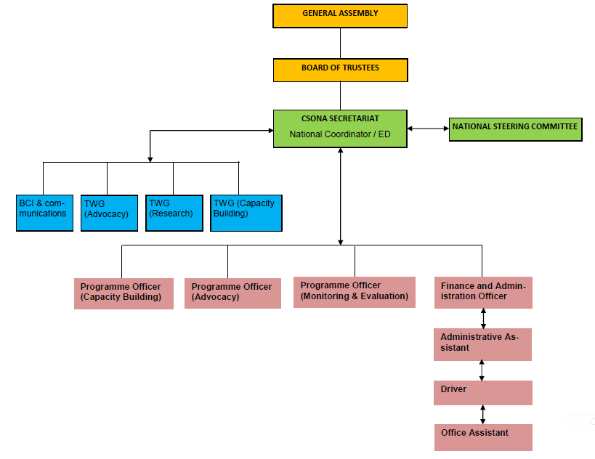
Structure of the secretariat

Slide 9
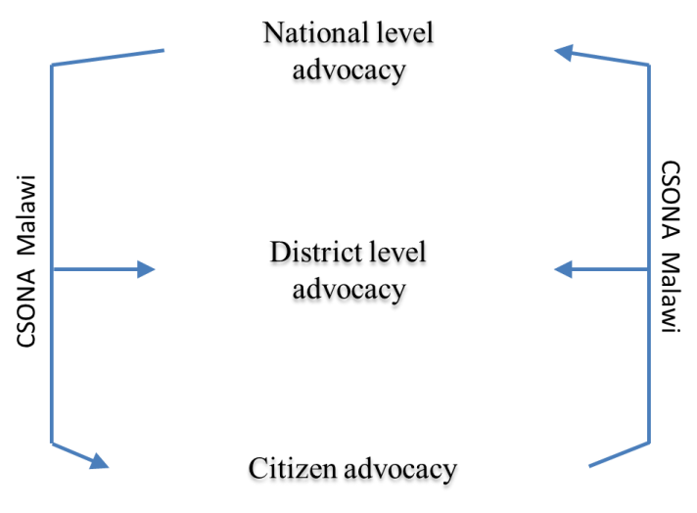
Key intervention area of the CSA and key achievements
Photo: Caroline Trutmann/Save the Children

Slide 10
Key intervention area of the CSA and key achievements
Key intervention areas
Influencing national policy, strategy and budgets
District-level coordination
Key achievements (and date)
Annual budget analysis & budget tracking (annually)
Nutrition champion building skills initiative (2014/15)
Citizen Advocacy & Social accountability (ongoing)
Capacity and landscape analysis (2015)
Strengthening capacity gaps around coordination, governance, advocacy and communication (on going)
Photo: Caroline Trutmann/Save the Children

Slide 11
Key intervention area of the CSA and key achievements
Key intervention areas
Strengthening adoption of a nutrition sensitive approach in social protection
Effective communication to targeted audiences
Key achievements (and date)
Policy & document analysis (2015)
Engaging in platforms at all levels to influence (ongoing)
Media engagement efforts
Social mobilization events that drive nutrition agenda and awareness (ongoing since 2014)
Development and dissemination of advocacy materials (bulletins, position papers, promo videos)
Social media platforms
Photo: Caroline Trutmann/Save the Children

Slide 12
Who are the most influential nutrition stakeholders in your country? Insert a Map of Stakeholders
Stakeholders | Role in the fight against malnutrition | Main nutrition specific initiatives
PUBLIC
Department of Nutrition, HIV and AIDS (DNHA), Government departments | Coordination, policy and decision making | Coordination
MP nutrition Champions | Policy and Decision making | Advocacy and lobbying for increased resource allocation Adoption of bills into acts (food and nutrition bill)
Academia | Research and innovation. | Capacity building and training Research

Slide 13
Who are the most influential nutrition stakeholders in your country? Insert a Map of Stakeholders
Stakeholders | Role in the fight against malnutrition | Main nutrition specific initiatives
PRIVATE
Food processing companies such as (Illovo sugar processing company, Rab processors) | Implementation | Fortification of food products such as vitamin A in sugar, Iodine in salt, Vitamins fortification in other processed foods
CIVIL SOCIETY
CSOs (local, INGOs) | • Nutrition advocacy, implementation | Implementation of the SUN high impact interventions (CMAM, IYCF, WASH e.t.c)
INTERNATIONAL COOPERATION
Development partners (donors) | Donors Coordinates the donors group on nutrition (DoNuts) Implements nutrition interventions (UN bodies e.g. UNICEF, WFP) | Donors provides funding for nutrition

Slide 14
CSA call For Action Statement
Create an enabling environment for effective community ownership and accountability for investments in nutrition.
”Afikepo”, let the children reach their growth and development potential.
Prioritise nutrition in the national development agenda and increase resource allocation towards nutrition.

Slide 15
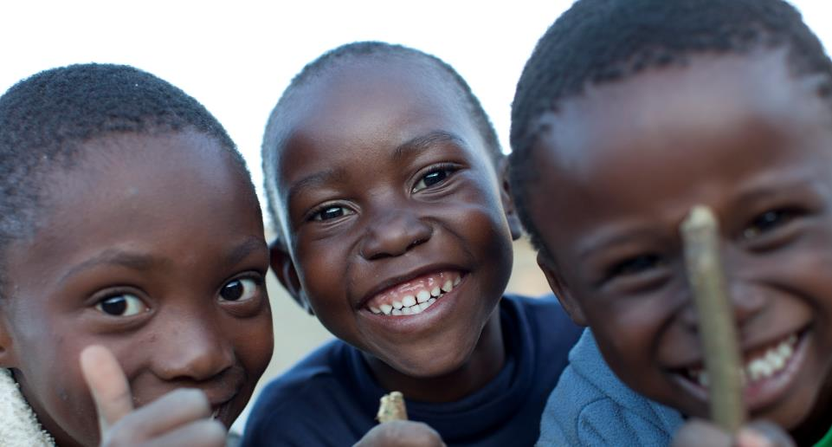
Thank you!
Photo: Adam Hinton/Save the Children

