Slide 1
Photo: Mark Kaye/Save the Children
Leveraging the Scaling Up Nutrition Civil Society Network: building regional platforms to promote learning on how to address malnutrition
The Learning Route in Rwanda
EXPERIENCE FAIR
30 October 2016, Kigali, Rwanda
Country Team Members: Victoria Squire, Sanusi Fofanah and Victor Lansana Koroma

Slide 2
Name of CSA: SUNI-CSP
Sierra Leone :
Insert log

Slide 3
What is the nutrition situation in your country?
Under Weight prevalence is 12.9% in children 6-59 months close to 12% Global target, Wasting is at 4.7%, Stunting 28.8%.
Exclusive Breastfeeding is 58.8% (exceeding global proposed target of 50% for 2022), and Colostrum feeding is 80.9%, Timely initiation of breastfeeding (within 1 hour of birth) is 54.9%.
Continued breastfeeding at 1 year is 86.0%
Minimum dietary diversity is 36.4%
Minimum meal frequency base don four or more food groups’ consumption is 14.4%
Analysis SMART 2014 shows steady decrease (wasting, underweight stunting) between 2008 and 2014.
Photo: Caroline Trutmann/Save the Children

Slide 4
SUNI Strength in Sierra Leone
Establishment of SUNI CSP to coordinate activities at district level
Established partnership with trusted community networks with larger reach to all communities for social mobilisation with Religious Leaders (6000). Market Women (4000) and traditional Healers to reach communities and mobilise using nutrition and health messages for behaviour change.
Established media wing of the Alliance (over 60 members across the country) to report on nutrition, immunization and health related issues
Advocacy to government for policy change: To include Right to Food in the National Constitution
Advocacy for specific budget line for nutrition with focus on MoHS, MAFFS and MoWR and Breast Milk Supplement (BMS)
Strong collaboration between civil society alliance with government, UN agencies, NGOs and other actors at national and district levels

Slide 5
What are the key National interventions to tackle malnutrition in your country?
The National food and nutrition security implementation plan 2013-2017 (Costed plan)
Establishment of SUN Secretariat at the Office of the Vice President. They coordinate nutrition activities of all partners/actors
Establishment of Food and Nutrition Security Networks in 8 districts (with support from FAO)
Strengthening SUN Coordination in all districts under the lead of local district councils

Slide 6
Main Challenges
Inadequate allocation of resources to nutrition
Ebola outbreak led to redirection of resources to the emergency- likely impacted on progress made in some nutrition targets (this needs to be measured)
Limited number of donors for nutrition in country (main donor is IrishAid)

Slide 7
Key Successes
Established the alliance in all districts. They are also recognized by government at national and district level and are represented in various national and district stakeholder committees/meetings
Trained civil society members, community networks and media for advocacy and social mobilization on nutrition and health (it is now easy to engage and mobilize them on various issues). They conduct activities across the country.
Coordinated the first National Health and Nutrition Fair 2016. Launched by the Vice President. Had 50 booths by various partners (CSOs, CBOs, EPI, DFN, MAFFS, Fisheries, UNICEF, WHO, WFP, HC3 BBC Media, Networks, National Aids Sec, HKI, CRS Well Woman Clinic, etc.) showcasing interventions such as LANN, and providing services for 3 days.
Succeeded in having Right to Food in the Draft Constitution (now in 2 sections of the draft, now advocating at district level to ensure communities and influencers are aware to vote “Yes” for the referendum)
Advocacy for Code for BMS (Supporting DFN. Minister is keen and has requested to chair the committee) meetings)

Slide 8
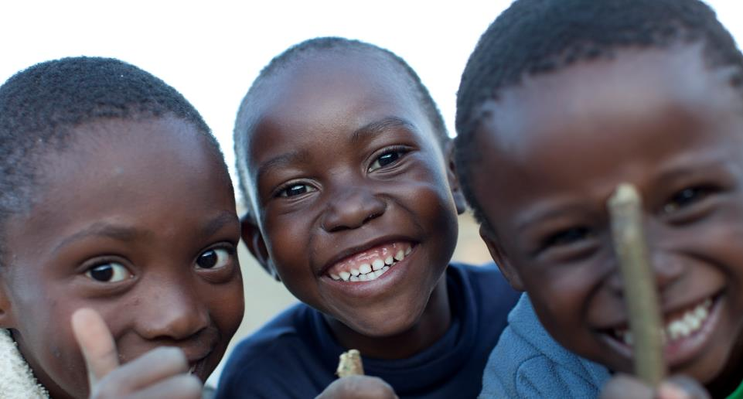
Thank you!
Photo: Adam Hinton/Save the Children

