Slide 1
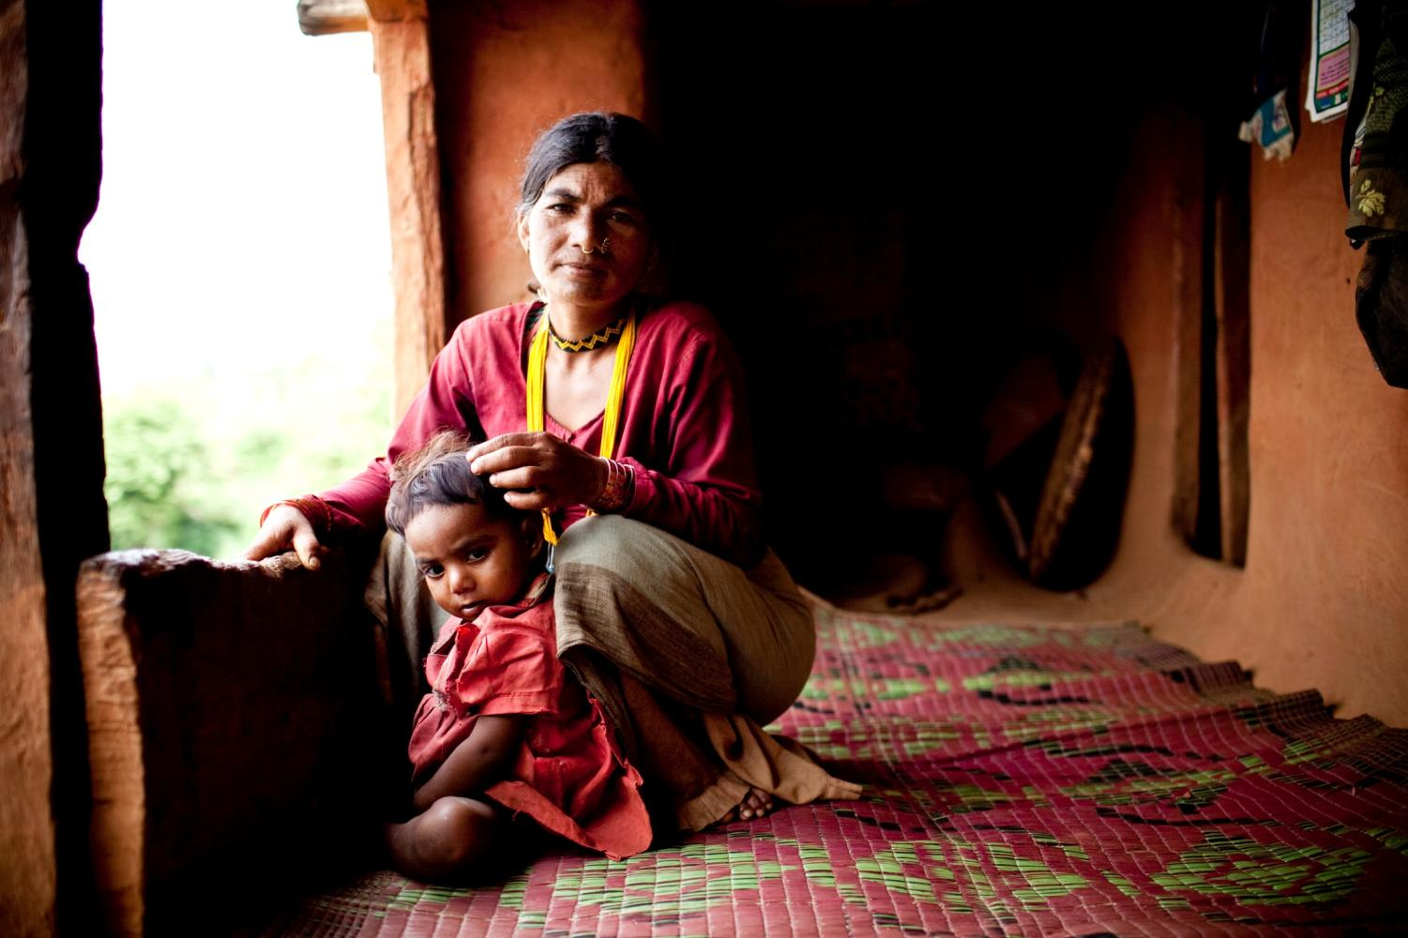
SUN is a unique
Movement
founded on the principle
that all people have a
right to food &
good nutrition.

Slide 2
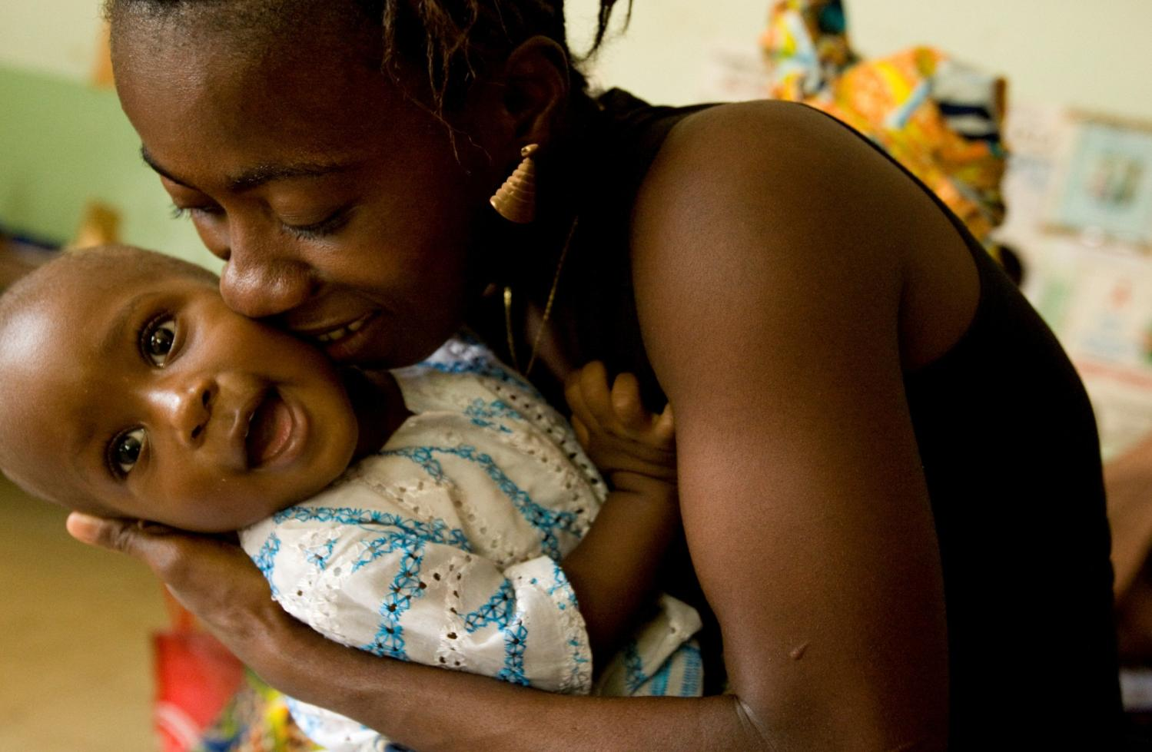
It unites people
from governments, civil society,
the United Nations, donors,
businesses & researchers –
in a collective effort to
improve nutrition.

Slide 3
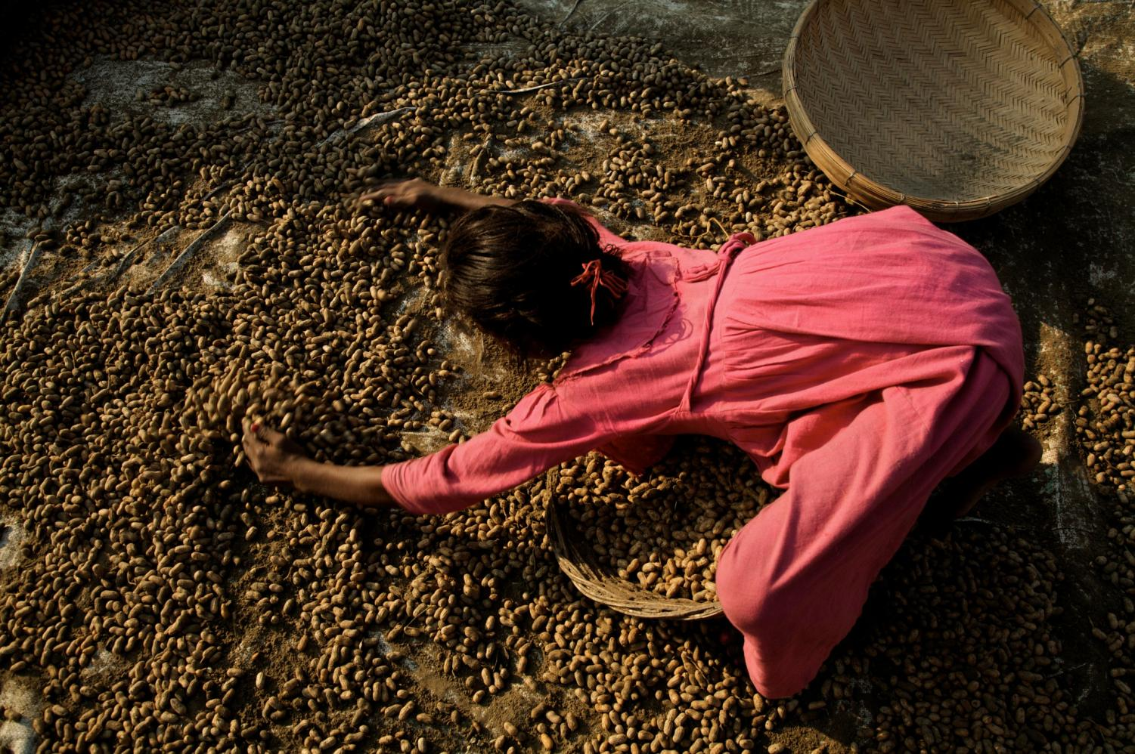
together
we can achieve
what no single effort could,
and make the world a
healthier, stronger
place for us all.

Slide 4
Nutrition-sensitive strategies increase the impact of
specific actions for nutrition
Specific Actions for Nutrition
Nutrition-Sensitive Strategies
Agriculture: Making nutritious food more accessible to everyone, and supporting small farms as a source of income for women and families
Clean Water & Sanitation: Improving access to reduce infection and disease
Education & Employment: Making sure children have the nutrition needed to learn and earn a decent income as adults
Health Care: Access to services that enable women & children to be healthy
Support for Resilience: Establishing a stronger, healthier population and sustained prosperity to better endure emergencies and conflicts
Feeding Practices & Behaviors: Encouraging exclusive breastfeeding up to 6 months of age and continued breastfeeding together with appropriate and nutritious food up to 2 years of age and beyond
Fortification of foods: Enabling access to nutrients through incorporating them into foods
Micronutrient supplementation:
Direct provision of extra nutrients
Treatment of acute malnutrition:
Enabling persons with moderate and severe malnutrition to access effective treatment

Slide 5
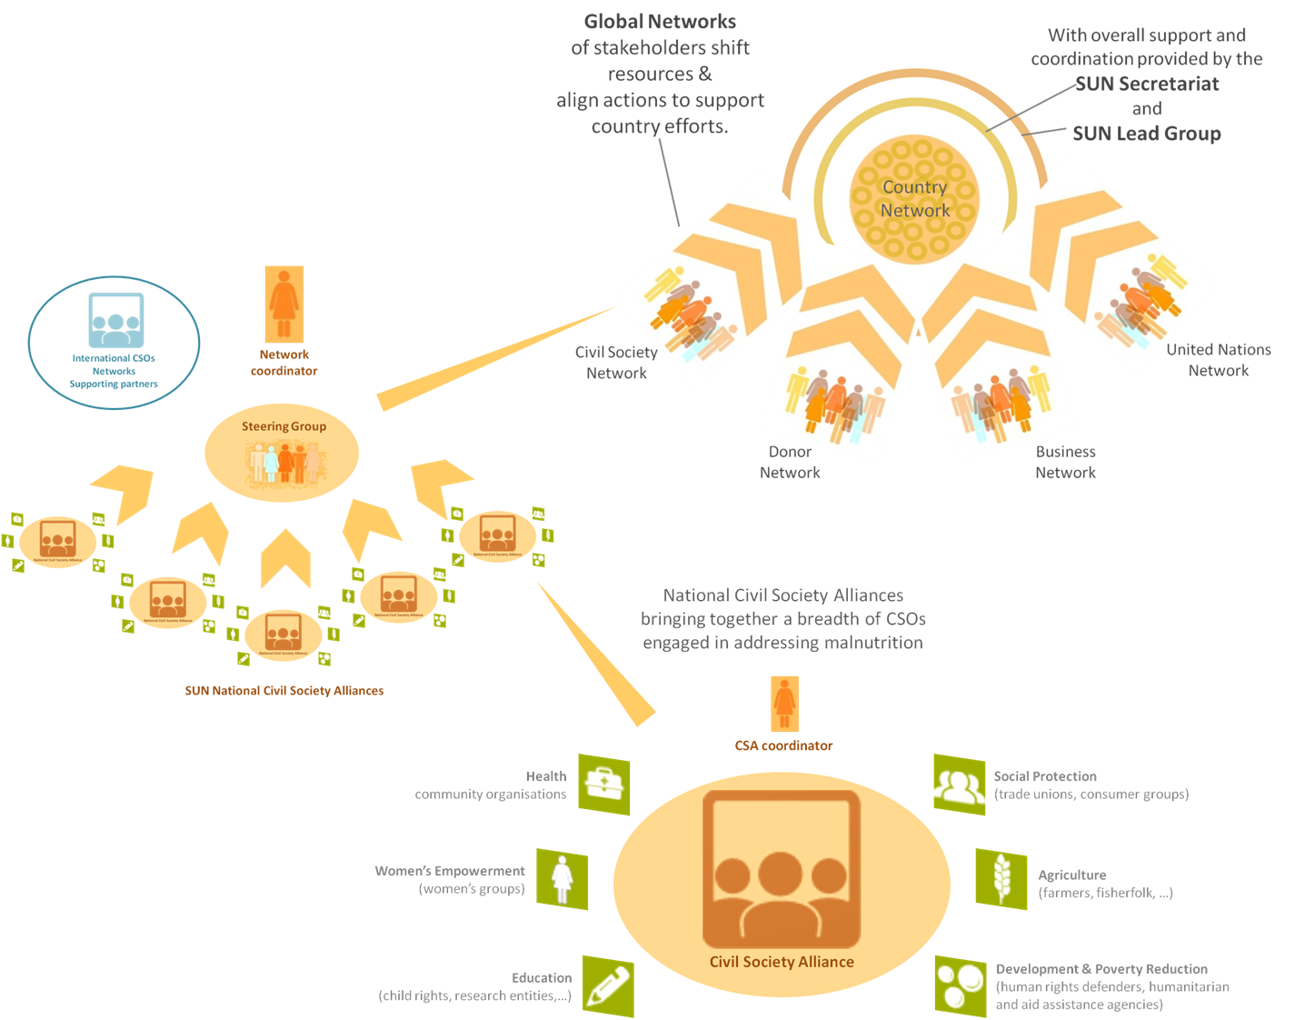
SUN Civil Society Network within the SUN movement
The SUN approach

Slide 6
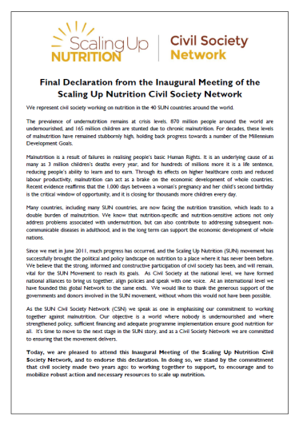
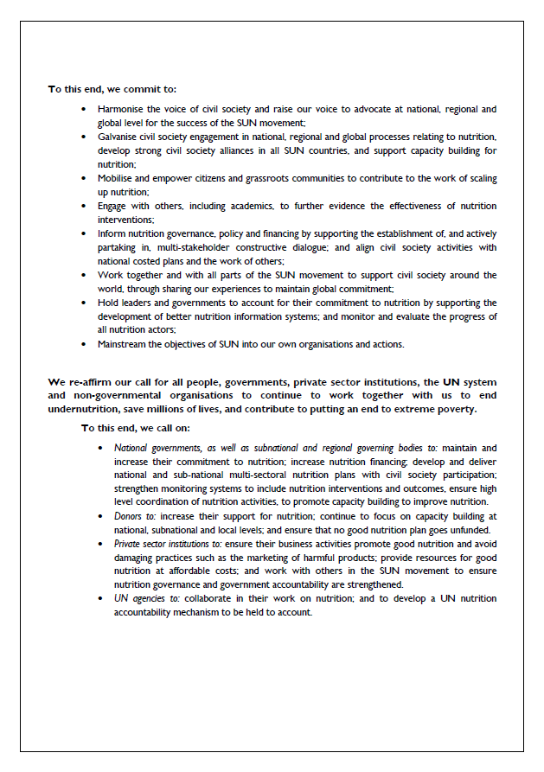
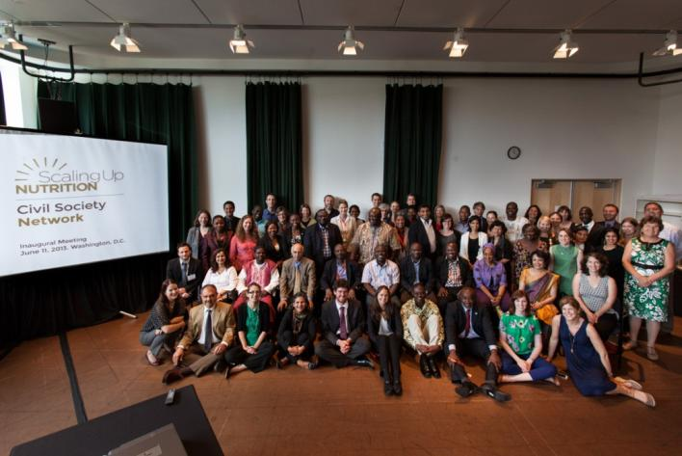
The SUN Civil Society Network (SUN CSN)
Civil society organizations collectively have a very powerful voice and can provide grass-roots support for scaling up nutrition locally.
SUN CSN was inaugurated on June 11, 2013 – a declaration reaffirming civil society’s commitment to support national efforts to scale up nutrition & discussions shaped priorities to guide the SUN Civil Society network agenda and actions.

Slide 7
SUN CSN Purpose
At the global level, the SUN CSN was established:
to support the formation and evolution of civil society alliances in SUN countries
to encourage the alignment of Civil Society Organisations’ (CSO) strategies, programmes and resources with country plans for scaling up nutrition
to encourage effective engagement from civil society in the SUN process at national and global level
to support Civil Society Alliances (CSAs) in SUN countries to advocate for the development of ambitious plans, contribute to the implementation and rolling out of national costed plans and hold stakeholders to account for the delivery of those plans.

Slide 8
SUN CSN Governance
SUN CSN governance
A chair - Brendan Cox (Director of Policy & Advocacy – Save the Children)
A secretariat and a coordinator – Claire Blanchard
An elected Steering Group
National SUN Civil Society Alliances (CSAs)
Supporting partners (still being defined)
SUN CSN – rotating hosting (current host organisation – Save the Children)

Slide 9
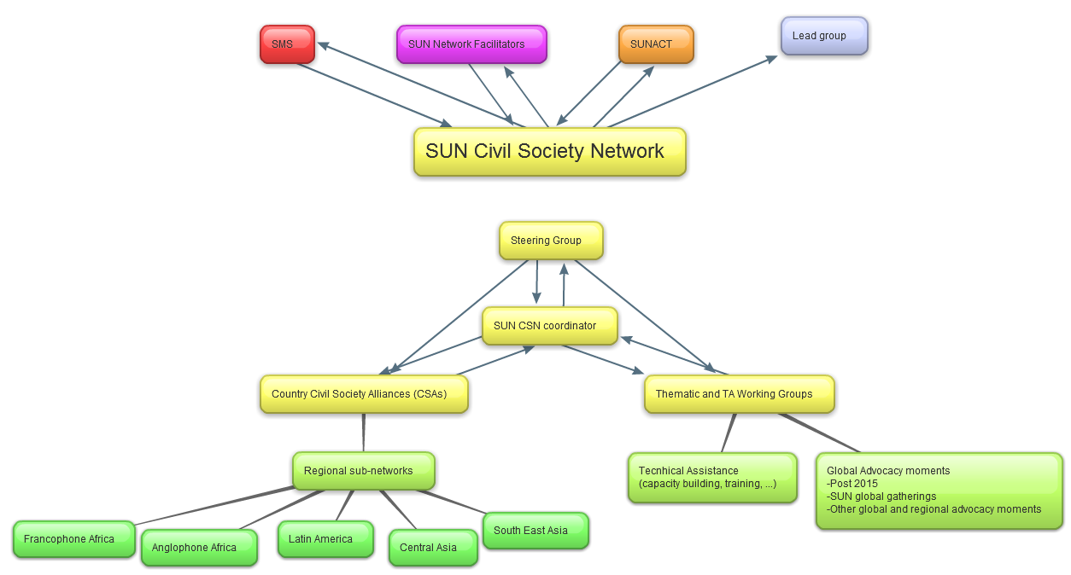
SUN CSN Governance Structure
This diagram includes both structures in place and planned structures to put in place.

Slide 10
A Broad constituency of CSOs
The Network is expanding rapidly – formalised SUN CSAs in 17 of the 43 SUN countries.
Active support from 12 international civil society organizations with a number of additional international civil society organizations interested in offering support to the network
The Civil Society Network reflects a broad constituency of civil society organizations
social movements
human rights advocates
national and international NGOs
women’s groups, youth associations
research entities
consumer groups and
trade unions
Notes:
Talk through / expand on what “active support” means in practice

Slide 11
A Steering Group
Role | Name | Position and Institution
Chair | Brendan Cox | Director of Policy, Advocacy and Campaigns, Save the Children UK
Steering Group members | Alangeh R. Che | Chairman of the non-state actors coordination team of the Comprehensive Africa Agriculture Development Programme (CAADP)
 | Asma Lateef | Director, Bread for the World Institute
 | Bourima Allaye Toure | President of national civil society council, Mali & Secretary General of OMAES, a Malian health and development NGO
 | Carolyn MacDonald | Nutrition Director, World Vision International
 | Elisa Pozzi | Asia Representative, Alliance Against Hunger and Malnutrition
 | Elise Rodriguez | Senior Advocacy Adviser, ACF, France
 | Francis Zotor | President, African Nutrition Society
 | Jennifer Thompson | Hunger Advocacy Officer, Concern Worldwide
 | Michael Krawinkel | Chair of the nutrition working group, International Paediatric Association, Germany
 | Milo Stanojevich | National Director, CARE Peru
 | Sultana Khanum | International Public Health Consultant, Bangladesh
 | Victoria Quinn | Senior Vice President Programmes, Helen Keller International,
 | Dr V Prakash | Council Member, International Union of Nutritional Sciences (IUNS), India
For more information contact: sun.csnetwork@savethechildren.org.uk
Notes:
The steering group membership in numbers (as of August, 2013):
Geographical: North America (3); Africa (3); Europe (4); Asia (2), Latin America (1)
Gender: Female (7); Male (6)
Cross-sectoral: food security, agriculture, health and academia/research.
Type of CSO: The membership comprises representatives from different CSO constituencies including farmer’s organisations, national and international INGOs, networks and academic associations.

Slide 12
National SUN Civil Society Alliances (CSA)
17 countries
National SUN Civil Society Alliances
Bangladesh
Burkina Faso
Burundi
Ethiopia
Ghana
Guatemala
Indonesia
Malawi
Mali
Mozambique
Nepal
Niger
Peru
Sierra Leone
Tanzania
Uganda
Zambia

Slide 13
National SUN Civil Society Alliances (CSA)
Building on pre-existing arrangements (e.g. Maternal and New Born Child Health), CSAs:
Co-ordinate civil society in country
Advocate for an increased focus on nutritional outcome in national policies and programmes
Work to ensure that Civil Society efforts to tackle malnutrition are aligned with national plans.
CSA comprise a number of member CSOs who amplify the voices of communities affected by the double burden of under-nutrition and obesity and focus on the need for greater accountability to them:
international and in-country CSOs actively engaged in scaling up nutrition at country level.

Slide 14
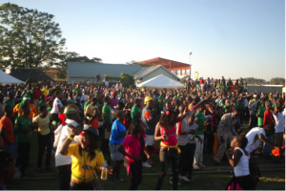
Zambia Civil Society SUN Alliance
Co-ordinate civil society in country & work to ensure that Civil Society efforts to tackle malnutrition are aligned with national plans
A broad membership - religious groups (Jesuit Centre for Theological Reflection), social protection organisations (platform for Social protection Zambia), research and academia, INGOs (CARE international, Save the Children, Concern Worldwide), poverty reduction CSOs, community organisations, youth organisations (National Youth Constituency Assembly)…) – nutrition-specific & nutrition-sensitive
A stakeholder mapping to broaden membership
Engaging with other CSOs working on development → making nutrition one of the important indicators of aid effectiveness + contribute to the formulation of the National Accountability Indicators on health of women and children.
Increasing awareness of CSO community – networking, joint actions and capacity building

Slide 15
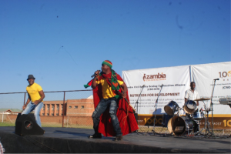
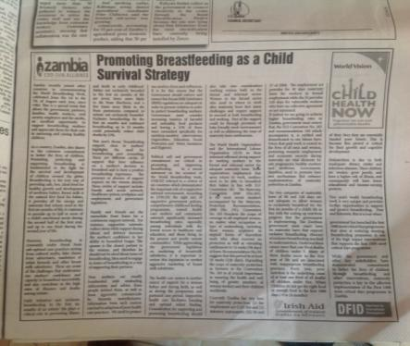
Zambia Civil Society SUN Alliance
Advocate for an increased focus on nutritional outcome in national policies and programmes
A member of the Multi-stakeholder Platform (MSP) along with government, UN, universities, manufacturers → formulate plans for scaling up nutrition & allocating roles
Global Day of Action & Participation in key high level events (Nutrition for Growth) → nutrition high on global and national agendas, a concert, an official song on 1000 days by Movi Pose Band
Coordinated CS actions – World Breastfeeding Week, Tax justice, Accountability and tracking of commitments
High media presence (radio, TV, newspapers)
Community awareness
Implement activities at the community level through CSO members of the alliance

Slide 16
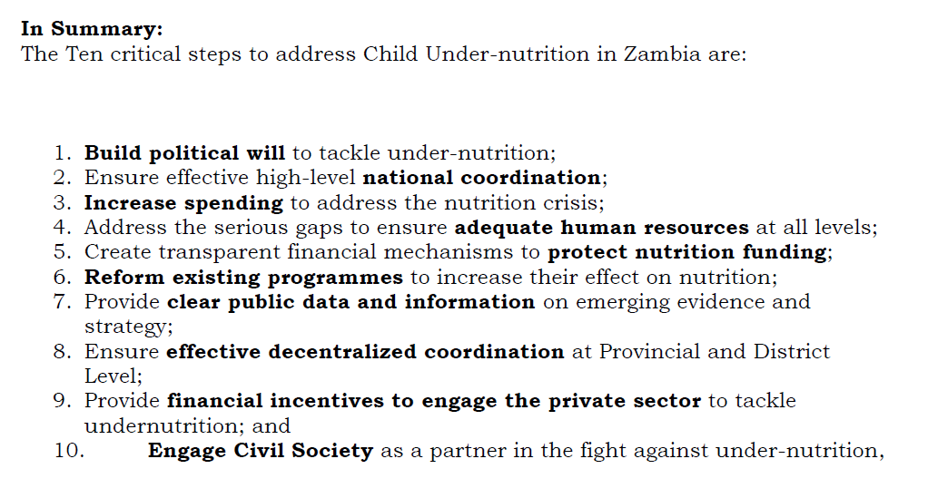
Zambia Civil Society SUN Alliance
Key asks from the government

Slide 17
SUN CSN Priority actions
Strengthening national civil society efforts (advocacy, implementation and monitoring)
Mapping – global and national levels
better understand the Civil Society landscape in SUN countries
identify gaps, needs and assets
ensure the network’s efforts are shaped from the bottom up.
Supporting the establishment of CSAs in at least 20 countries end 2014
Capacity Building of CSAs
Providing one on one support - a buddy system Steering Group & CSA
Guidelines and tool kits to support civil society throughout the Movement (a guidance note to establishing a CSA in SUN countries informed by experiences so far, an “advocacy tool kit” with key messages to enable us all to “sing the same song”, guidance on how to engage with private sector, farmers group, etc. and how to manage conflict of interests).

Slide 18
SUN CSN Priority actions
Strengthening national civil society efforts (advocacy, implementation and monitoring)
Supporting effective multi-sectorial partnerships - facilitating connections when possible and connecting with broader SUN efforts.
Playing an evaluation role through systematised regular reporting in line with SUN monitoring and evaluation framework.
Channelling opportunities for funding toward countries in need.
Supporting actors throughout the Network to mobilise citizens and get grassroots organisations involved in SUN, working towards a groundswell of grassroots support for nutrition and SUN.

Slide 19
SUN CSN Priority actions
Facilitating cross-learning and exchange of knowledge, expertise and experiences
A Communications Strategy to:
Ensure adequate flow of information within and among countries and within and amongst networks and other SUN actors
Foster cross-learning and exchange of knowledge, experiences, processes, and evidence between SUN countries
Support the establishment of regional sub-groups of the network for Asia, Francophone Africa, Anglophone Africa and Latin America
Facilitate capacity building strategy implementation
Ensure dissemination of SUN experiences within the network, within SUN and more broadly to the general public and other key stakeholders in the field
Ensure equitable availability, access and use of information in French, English and Spanish
Capitalise on opportunities for raised visibility and advocacy
Support for effective and co-beneficial multi-sectorial partnerships.

Slide 20
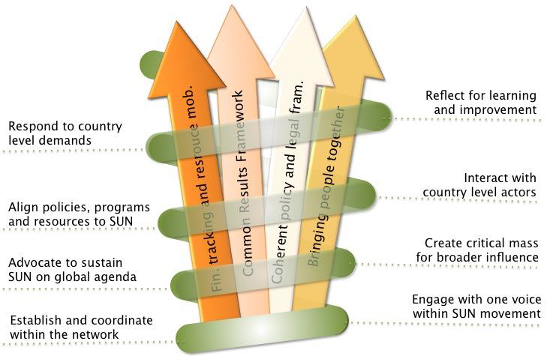
SUN CSN Priority actions
Ensuring that national level advocacy and implementation efforts at the national level translate to global leadership
Facilitating a reporting process that captures progress of vital Civil Society advocacy and implementation efforts in SUN countries around the 4 SUN processes:
Capturing lessons learnt in a manner that will be available and relevant to the global arena
Advocating – influencing country and donor policies and priorities, specific policy changes and integration of nutrition in global policies

Slide 21
Advocacy at the heart
Advocacy for nutrition at the national level continues to be strengthened
Linkages to the global agenda have been limited and depended on relationships between key individuals
A major global advocacy success - CSOs have worked in a concerted manor to influence global nutrition events:
Hosting a ‘Global Day of Action’ to galvanize political commitment to nutrition in the run up to the Nutrition for Growth Event and the G8
Contributing to the success in securing commitments at the Nutrition for Growth event
Coordinating efforts to speak to governments with a common voice on the need to scale up financing for SUN countries national nutrition plans

Slide 22
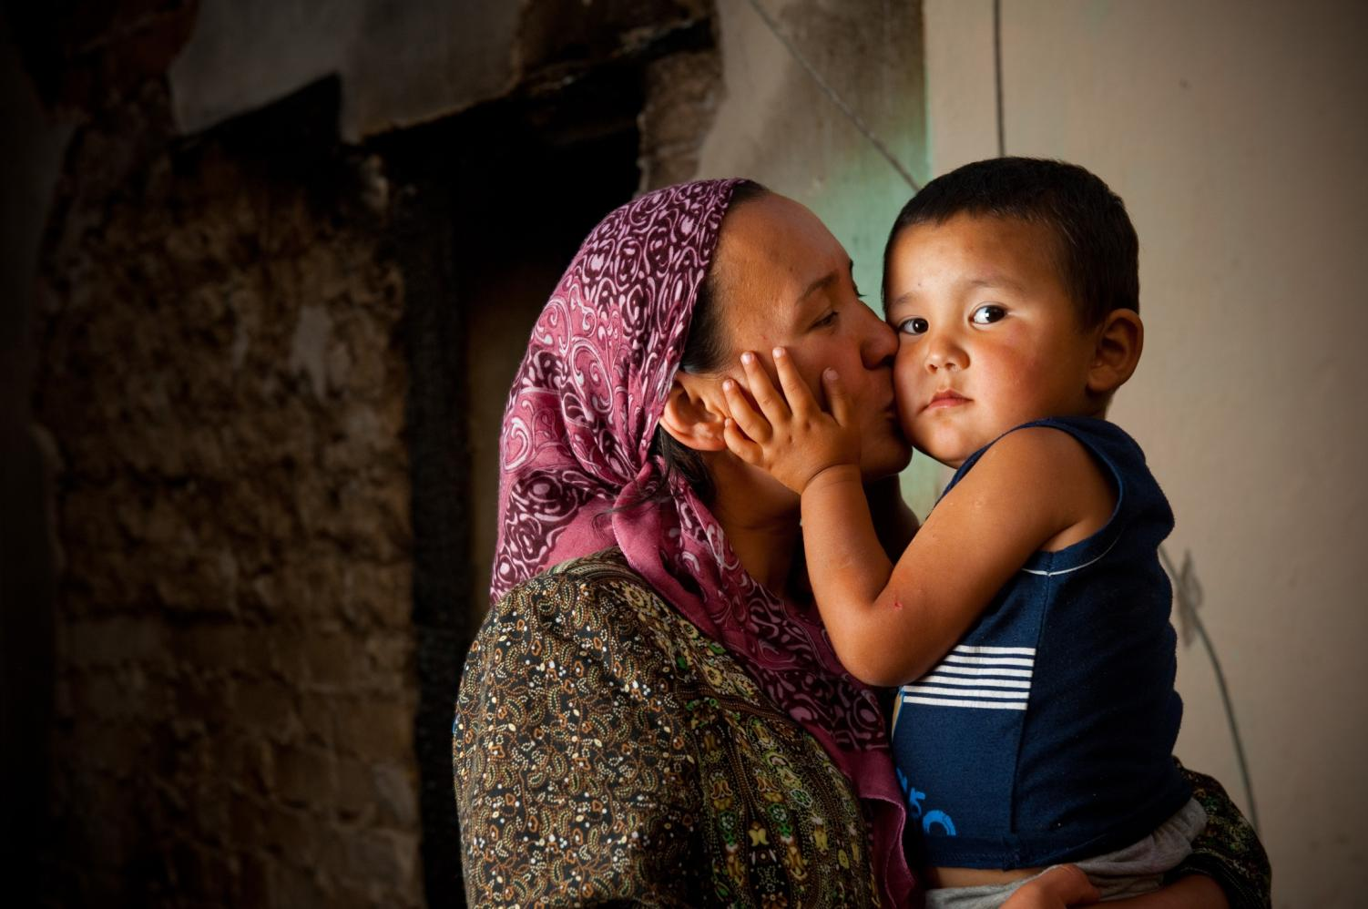
Together….
We are revealing what
has been hidden to all.
We are making healthier
& stronger societies.
Our goal is a better
world for all
…especially our
children
Thank you

