Slide 1
What is the OECD Nutrition Policy Marker (NPM)?
A voluntary, qualitative tool to identify donor investments with a nutrition objective, making data publicly available
  It can be used across sector codes
  It can track the number and share of projects with an NPM score within a sector
  It can track commitments and disbursements to projects with a nutrition objective or indicator over time (NOT the estimated amount going specifically to nutrition actions)
OECD Guideline defines eligibility:
A project is eligible for an NPM score if:
It is reported under the basic nutrition purpose code, or
It contributes to a nutrition-sensitive outcome and the project documentation includes an explicit nutrition objective or indicator
NPM Value
2 | Nutrition is the principal objective of the action and is fundamental in its design and expected results
1 | Nutrition is an important and deliberate objective, but not the principal reason for undertaking the action
0 | Action has been screened against the marker, but has not been found to target nutrition in any significant way
Notes:
A note on interpreting the NPM: Within the OECD Creditor Reporting System (CRS), the NPM is applied to commitments and disbursements at the project level (some donor institutions apply it at the sub-project level, but the same logic applies). If correctly applied, the score indicates that the project to which it’s applied has a basic nutrition purpose code or contains a nutrition objective or indicator. We interpret the NPM as telling us the monetary value that’s disbursed to a project with a nutrition objective or indicator, then, not that the monetary value is all going to the nutrition objective or indicator. To report the estimated amount going specifically to nutrition actions within the project, we would need to be able to separate and identify the amount of money going only to nutrition within the project, which CRS reporting – and therefore the NPM – does not do.
For example, we can say, “In 2020, Donor A disbursed $1.7 billion to 1,200 projects with a nutrition objective or indicator.” We cannot say “In 2020, Donor A disbursed $385 million to nutrition activities within 1,200 projects.” The NPM is a qualitative tool that does not quantitatively assess the proportion of that disbursement that went specifically to nutrition actions within those projects.

Slide 2
Why is the NPM important?
Overall goal for nutrition programming more broadly: To mainstream nutrition within large-scale programs across sectors to optimize use of resources and improve nutrition outcomes
The NPM contributes to this goal in two ways:
Actively identify opportunities for improved nutrition mainstreaming: Could provide a process for program officers to review large-scale programs for nutrition relevance, encouraging adaptation of programs and optimizing nutrition
Track progress to improve transparency and accountability: Provides greater insight into multi-sectoral aid for nutrition than previously available, standardized across donors
More robust data will allow us to improve planning and coordination to tackle complex problems, better target and track investments in nutrition, and ultimately scale up more sustainable programs with nutrition actions across sectors to reduce the global burden of malnutrition.
Notes:
A note on improved insights from the NPM: Before the NPM was introduced, most donor institutions used the SUN method to report nutrition financing estimates to the Global Nutrition Report (GNR). Unfortunately, the SUN method lacks transparency and consistency. Donor institutions calculate their nutrition contributions internally based on variations of the SUN methodology and then report a finance estimate that the public cannot recreate, making comparisons challenging. The NPM, on the other hand, is a more transparent reporting method. Because it’s reported within the public OECD CRS database, all data users can see which projects received which scores, and then calculate the amounts committed or disbursed accordingly. The NPM data can also be disaggregated by any variable reported in the extensive CRS database. That means that data can now be reported by commitments, disbursements, recipient (country, region, etc.), by channel type (UN institution, private sector, NGO, etc.), and more. Perhaps most importantly, this data can also easily be sliced by sector and purpose codes, to highlight nutrition across all investment types. The ability to look across sectors in this level of detail gives us greater insight into progress and opportunities to mainstream nutrition within and across them.

Slide 3
FEATURES THAT MAKE the NPM A POWERFUL RESOURCE TRACKING TOOL
The NPM is most often* applied by project/program officers who know the project best, instead of by a central data or statistics team.
The NPM is most often* applied at the beginning of a project, instead of retroactively, meaning it can be a conversation starter about nutrition integration and inform design.
The NPM data can be disaggregated by sector, or any other field reported to the CRS, which improves transparency, granular information, and the ability to answer more complex questions about the nutrition financing landscape.
The NPM data is reported to the publicly available OECD CRS database, which means all data users can see which projects received NPM scores, greatly improving reporting transparency and accountability.
*A note on application: These features are based on best practices for NPM application, which several SDN members have achieved. Some SDN members are not yet applying the policy marker during project design but are working toward doing so.

Slide 4
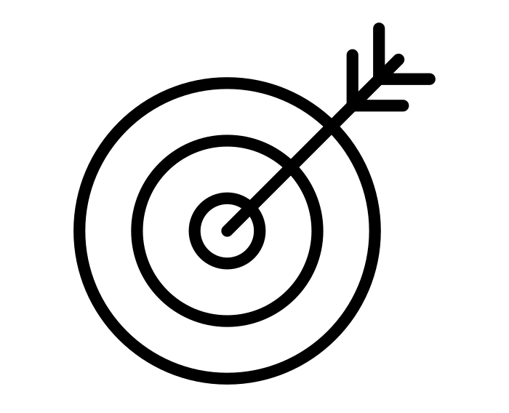
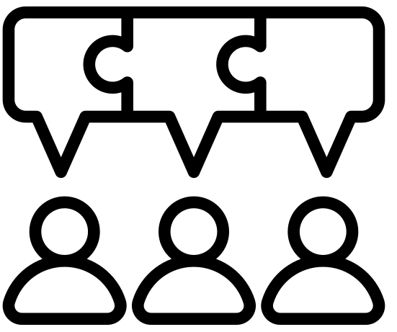
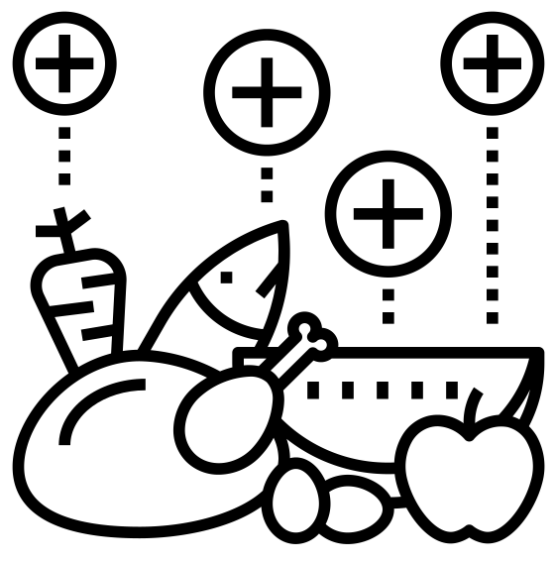

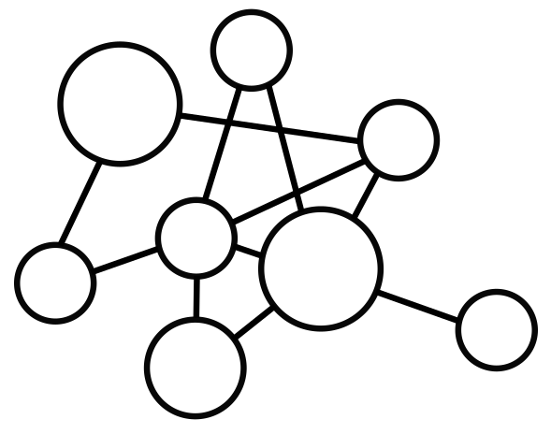

Benefits of the NPM as reported by SDN members
Accuracy: Because the NPM can be applied at the start of the project by the project/program officers themselves, it is more likely to be accurate.
Staff buy-in and sensitization: Since application is often done by project/program officers instead of a centralized data or statistics team, more staff are brought into the resource tracking process and therefore understand how the estimates are generated, what they’re used for, and why they’re important.
Nutrition mainstreaming: Since a project can be reviewed for the appropriate NPM score during design, the NPM can be an effective internal advocacy tool to promote increased nutrition mainstreaming through the inclusion of nutrition objectives and/or indicators that may not otherwise have been considered.
Better access to data when you need it: The resource tracking information is available significantly earlier than with retroactive application methods (e.g., 2013 SDN method) because the NPM score is visible the moment the programs are added to the internal reporting system(s). When it is integrated within internal systems, country offices can also access it to respond to requests from country governments. (Note there is a two-year lag for public reporting via the OECD CRS.)
Breaks down silos: Seeing nutrition investments across all sectors in the CRS allows organizations to assess trends and fluctuations beyond basic nutrition, bringing more nuance to the nutrition discussion and allowing users to tell a story across bureaus.
Demonstrate leadership: Commitment to this level of transparency, proactivity, and granular evidence generation demonstrates institutional leadership in data-driven programming.

