Slide 1
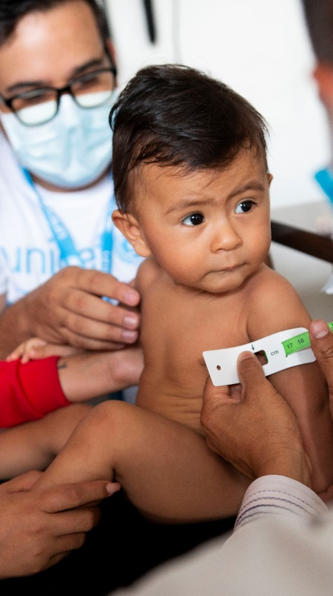
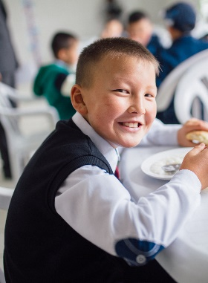
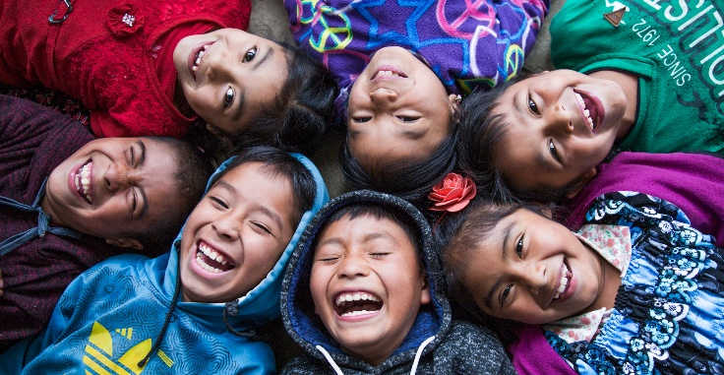
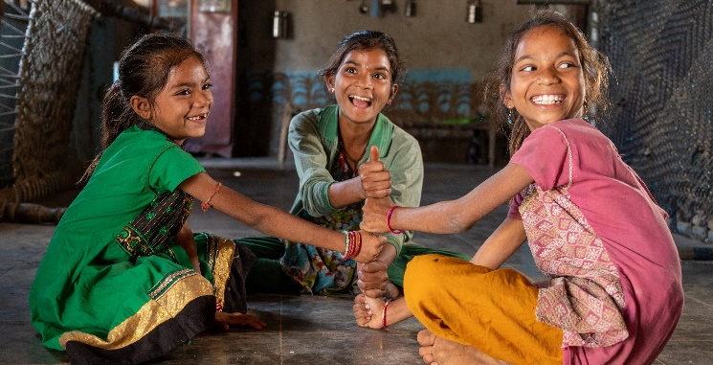
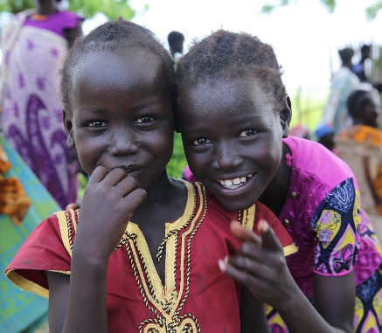
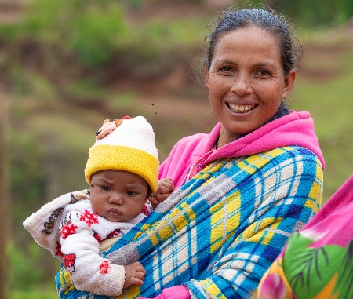
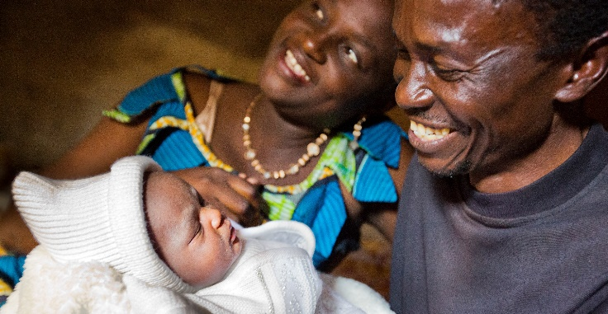
THE SCALING UP NUTRITION (SUN) MOVEMENT IN 2021-2025
SUN is a unique Movement founded on the principle that all people have a right to food & good nutrition.
Photos: © UNICEF

Slide 2
The SUN vision
By 2030, a world free from malnutrition in all its forms.
Led by countries and governments, supported by organisations and individuals – collective action ensures every child, adolescent, mother, and family can realise their right to food and nutrition, reach their full potential and shape sustainable and prosperous societies.

Slide 3
Why nutrition?
People: Good nutrition during the first 1,000 days of a child’s life is critical to achieving full physical, intellectual and human potential in adolescence and adulthood
Prosperity: Every dollar invested in nutrition in developing countries yields approximately USD 16 in economic returns
Planet: A global shift towards more plant-based diets and reducing food and agricultural waste are among the tactics with the largest potential for reducing emissions and curbing global warming, while improving people’s health
Partnership: There is no single actor who can address all underlying causes of malnutrition; the 2030 Agenda calls on actors to align themselves with the intergovernmental agreed nutrition targets and contribute from their respective mandate and comparative strengths
Peace: Improved nutrition helps to break the intergenerational cycle of inequity and poverty - contributing to a more peaceful society

Slide 4
Faster results needed!
MALNUTRITION IN GIRLS AND BOYS UNDER FIVE
(2010-2019)
There are almost 2.7 billion women, men and children that call our countries and Indian States home today, with some 320 million girls and boys under the age of five. These children represent:
76% of all stunted children
64% of all wasted children
28% of all overweight children
23% of all girls and boys with low birthweight
171
million
144
million
52
47
43
million
million
million
38
million
STUNTING
WASTING
OVERWEIGHT
2010
2019
2010
2019
2010
2019
More information: UNICEF/WHO/World Bank Group – Joint Child Malnutrition Estimates 2020 edition

Slide 5
The challenge
The triple burden of malnutrition is on the rise:
The coexistence of undernutrition (stunting and wasting), micronutrient deficiencies, and overweight and obesity, has risen dramatically in recent years. Challenges are greatest in conflict-affected and fragile contexts
COVID-19 is rolling back years of progress:
Malnutrition exacerbates the impacts of COVID-19. Undernutrition compromises the body’s immunity and cognitive development, while obesity predisposes women and men to the most serious impacts of COVID-19
Nutrition actions are only successful if they address systemic drivers:
Poor health, political instability, socio-economic and environmental vulnerabilities, gender inequalities and lacking human rights

Slide 6
The Movement today
Kyrgyzstan
Uttar Pradesh State
Tajikistan
Afghanistan
Nepal
Pakistan
Maharashtra State
Burkina Faso
Jharkhand State
63 countries and the Indian States of Maharashtra, Jharkhand, Madhya Pradesh and Uttar Pradesh have committed to scaling up nutrition and are working collectively, as a Movement
Mali
Niger
Central African Republic
Bangladesh
Mauritania
Chad
Myanmar
Senegal
Nigeria
Sudan
Lao PDR
Haiti
South Sudan
Viet Nam
Honduras
The Gambia
Uganda
Philippines
Guinea-Bissau
Yemen
Madhya Pradesh State
Indonesia
Guatemala
Ecuador
Guinea
Timor-Leste
Sierra Leone
Somalia
El Salvador
Peru
Liberia
Ethiopia
Sri Lanka
Côte d’Ivoire
Kenya
Cambodia
Costa Rica
Ghana
Tanzania
Togo
Comoros
Rwanda
Benin
Burundi
Cameroon
Madagascar
Gabon
Malawi
Congo
Mozambique
Zimbabwe
DRC
Eswatini
Namibia
Botswana
Zambia
Lesotho
SUN countries and 4 Indian States
2010
2011
2012
2013
2014
2015
2016
2017
2018
2019
2020
2021
19
33
42
55
57
59
60
60
61
62
63
LAUNCH

Slide 7
The SUN approach
Once seen as an issue to be tackled through public health interventions, the importance of a concerted approach is now widely accepted, involving:
• Multiple stakeholders, supported by the UN, civil society, business, academia and donors
• Multiple sectors, including health, agriculture, women’s empowerment, planning, education and more
“Defeating malnutrition, united with multiple sectors and stakeholders in a truly coherent approach, is no longer an abstract aspiration – it is the new normal.”
SUN Movement 2015 progress report
Civil Society Network (CSN)
SUN Business Network (SBN)
SUN Country Network convened by the SUN Government Focal Point
SUN Donor Network (SDN)
UN Nutrition
SUN Movement Coordinator, Lead Group, Executive Committee and Secretariat

Slide 8
SUN progress at a glance
THEN
NOW
In 2011, 10 SUN countries (or 53%) had an active multi-stakeholder platform (MSP) at the national level
In 2020, 58 SUN countries (or 93.5%) had an active multi-stakeholder platform at the national level. 48 countries work sub-nationally
In 2011, 13 countries had confirmed a donor convener, 4 countries had formalised their civil society engagement and 6 countries ensured engagement with business
In 2020, 31 SUN countries reported having 3 of 4 networks (UN, business, donor and civil society networks) for coordination of nutrition actions
In 2020, 49 countries (79%) had a national nutrition plan bringing together sectors and stakeholders in a whole-of-government approach to address malnutrition
In 2012, 17 (or 60%) of SUN countries had costed national nutrition plans
However, the scaling up, alignment and disbursement of funding remains a challenge

Slide 9
Our theory of change
OUR VISION
By 2030, a world free from malnutrition in all its forms
OUR GOAL
Speeding up progress towards World Health Assembly global targets on all forms of malnutrition
OUR OBJECTIVES
Greater priority given to nutrition in national development
Country priorities are scaled up
OUR APPROACH
Collective, coherent and evidence-based action leads to accelerated nutrition progress and systemic change at the national and sub-national level

Slide 10
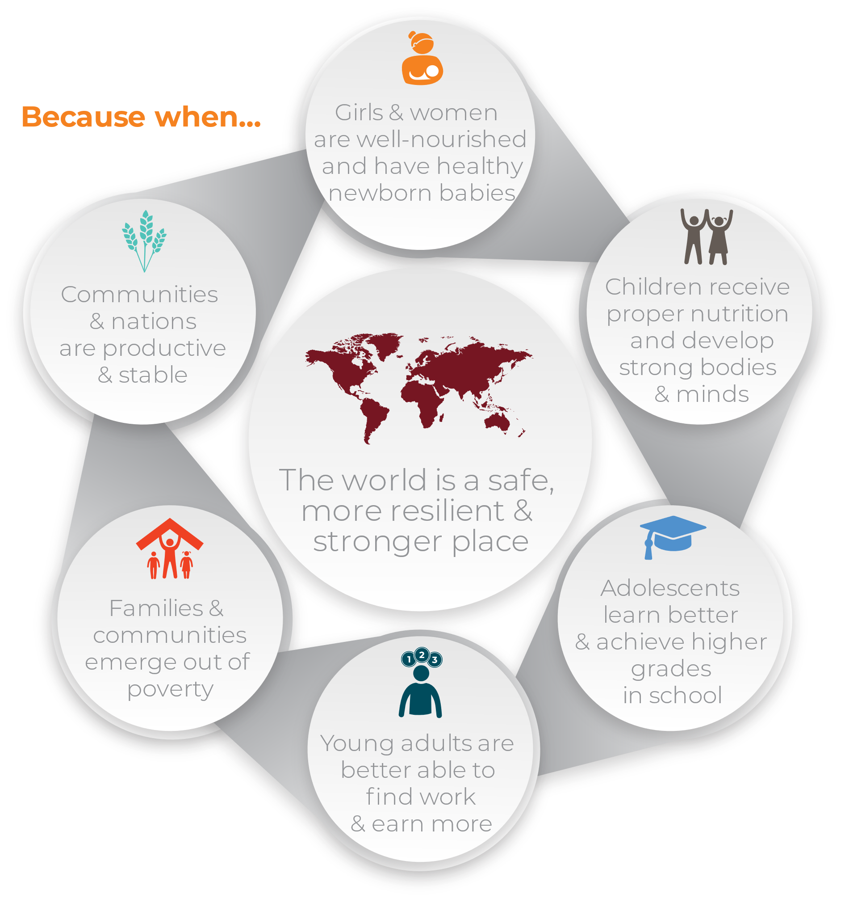
Our theory of change
FUNDAMENTAL BASIS
FUNDAMENTAL BASIS
Food systems deliver healthy, affordable food
Safe drinking water, sanitation and hygiene services supports nutrition
Health systems provide quality nutrition services for all
Improved nutrition leads to gender equality, improved gender equality leads to improved nutrition
Social protection systems integrate nutrition outcomes, particularly the first 1,000 days
Nutrition placed at the forefront of tackling the climate crisis on national and international agendas
The private sector shifts its resources & core business and aligns with global and national norms
Civil society and community-based organisations are promoted to ensure voices are heard
An independent humanitarian space and actors are promoted and protected for impartial needs-based and assistance
Girls’ education is crucial to improved nutrition

Slide 11
Our strategic objectives
OBJECTIVE 1
Strengthen and sustain strong policy and advocacy to position nutrition outcomes
Nutrition is embedded in National Development Plans
Country coordinator offices are established in high-level institutions within governments, where possible, such as Prime Minister’s Offices and ministries of planning
Significant policy/legislation is passed that enables effective nutrition action
All SUN stakeholders make commitments at the N4G Summit to support the new Strategy and to enhance efforts to implement it
ILLUSTRATIONS OF WHAT SUCCESS WILL LOOK LIKE IN 2025*
*SMART indicators, together with a risk matrix, will be developed during the operationalisation phase to make outcomes measurable

Slide 12
Our strategic objectives
OBJECTIVE 2
Develop and align shared country priorities for action
Country priorities are established and all
stakeholders commit to align with them
Plans to implement priorities are executed
Coverage rates for nutrition programmes increase
ILLUSTRATIONS OF WHAT SUCCESS WILL LOOK LIKE IN 2025*
Domestic funding for nutrition action increases
Donor funding for nutrition action increases
Funding from innovative sources increases
*SMART indicators, together with a risk matrix, will be developed during the operationalisation phase to make outcomes measurable

Slide 13
Our strategic objectives
OBJECTIVE 3
Build and strengthen country capacity with technical assistance and knowledge management
Country stakeholders are better coordinated and aligned
The Networks, the Secretariat, the Coordinator, the Executive Committee and the Lead Group are rated as working well
together to support countries (from 360-degree accountability mechanism)
Knowledge products and tools are more responsive to country needs and their uptake increases
The SUN Movement is equipped to allow an external evaluator to determine SUN value-add to outcomes and to ways of
working that promote those outcomes
ILLUSTRATIONS OF WHAT SUCCESS WILL LOOK LIKE IN 2025*
*SMART indicators, together with a risk matrix, will be developed during the operationalisation phase to make outcomes measurable

Slide 14
Our strategic objectives
OBJECTIVE 4
Ensure SUN governance promotes country leadership and government responsibilities, aligns resources and strengthens mutual accountabilities
Roles and responsibilities are agreed and understood by all
All stakeholders embrace routine accountability
The 360-degree accountability mechanism is implemented successfully
Conflicts of interest are identified and addressed in a pragmatic manner
ILLUSTRATIONS OF WHAT SUCCESS WILL LOOK LIKE IN 2025*
*SMART indicators, together with a risk matrix, will be developed during the operationalisation phase to make outcomes measurable

Slide 15
Next steps
Ensuring mutual accountability of all parts of the Movement will be a key next step in the strategy roll-out
SMART indicators – those that are specific, measurable, achievable, relevant and timebound – together with a risk matrix, need to be developed during the operationalisation phase, to make outcomes illustrated in the strategy measurable. These indicators will be key inputs into a unified accountability framework
The Strategy should be seen as a living document
It will evolve with the process of operationalisation and continuous review throughout 2021 to 2025
The Strategy is country-led and country-driven
This is essential in both operationalisation and implementation, as well as building on the SUN Movement, multi-stakeholder, multi-sectoral and systems approach
The SUN Operationalisation Group (SUN Ops), comprises representatives from across the Movement
It is working on a set of recommendations in relation to (a) accountability and governance and (b) delivery.
It is expected that these recommendations, once approved by the Lead Group, will give direction in support of the shift to true country ownership of the Movement

Slide 16
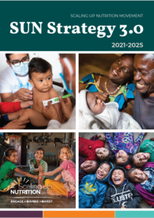
Learn more
SUN Strategy 2021-2025
Learn more: SUN Movement Strategy and Roadmap

Slide 17
www.scalingupnutrition.org
www.facebook.com/SUNMovement
www.twitter.com/SUN_Movement
But we must not be complacent.
We can achieve zero hunger and malnutrition in our lifetime.
Photos: © UNICEF

Slide 18
SUN Icons

